Slide 1

A Search for better Residential Rental investment in
Toronto neighborhood
Finding needle in a Haystack

Slide 2
Business Requirement
Client wants to know the best profitable neighborhood to invest in rental condominiums in Toronto.
The search is centered around localities with universities and school districts aiming at temporary residents.
Locations must have atleast few to several public transit options.

Slide 3
Understanding the data
Data is aquired from public data set.
Neighborhoods in approximately 10 Boroughs analysed.
Four Square client API used to obtain nearby Venues for locations of interest.
Only Data from assigned Boroughs and their Neighborhoods are used.
Subset of venue categories of four Square database used for the analysis.
Neighbourhoods with data discrepancies in coordinates or venues are eliminated.

Slide 4
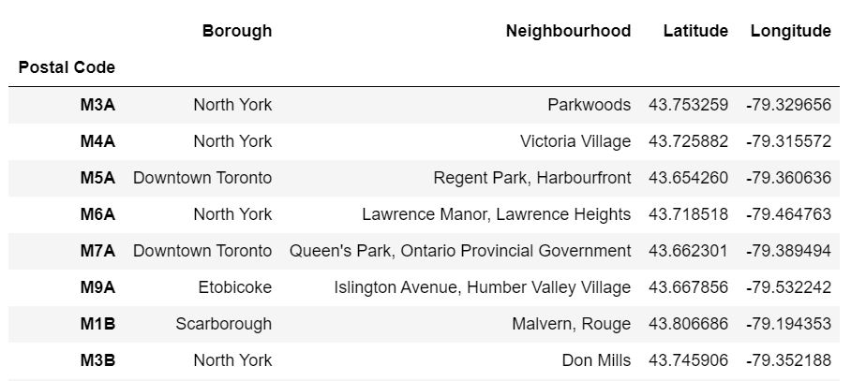
Toronto neighborhood dataset snippet
Data set is obtained after cleaning the public data set of Toronto neighborhoods.The dataset has total of 10 Boroughs and 103 Neighbourhoods.

Slide 5
Four Square client for extracting Venues in neighborhood
FourSquare API is a real time location based service that provides information of venues,users and photos and checkins.
Foursquare API is used to generate the near by venues by formulating the suitable URI.
Current analysis has considered only venue categories under Universities , colleges schools,airport and public travel options.
API is requested with all venues in above categories within the radius of 1km.
Around 2143 venues extracted for 103 neighborhoods.

Slide 6
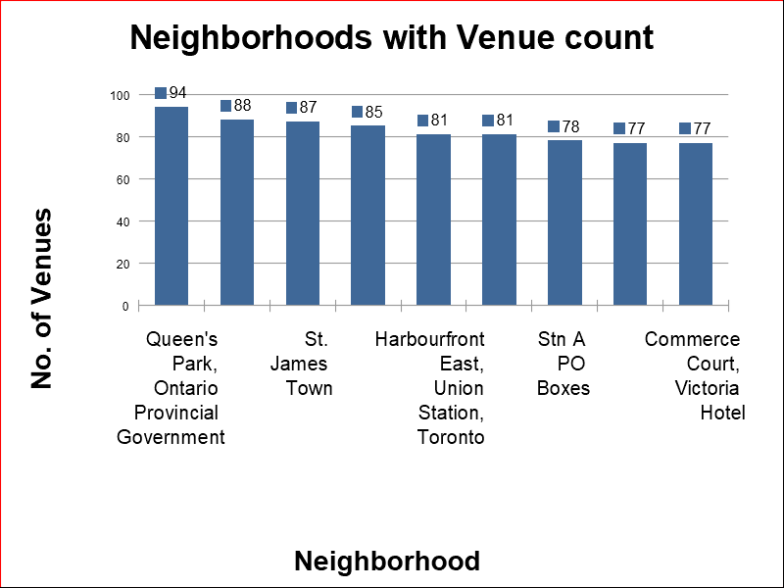
Displaying only 10 Neighborhoods out of 103 with maximum number of Venues under selected Venue categories

Slide 7
Further Data Cleaning
Data is filtered at venues sub-category level.All the sub -categories under selected categories that are redundant or not useful are eliminated.e.g university auditorium under university .
One Hot encoding technique is performed on data.Also , mean for each venue category is calculated.Mean() here calculates the frequency of occurence of each venue category
One hot encoding is done to convert the categorical values to numerical. This is necessity for applying any machine learning algorithms on the dataset.

Slide 8
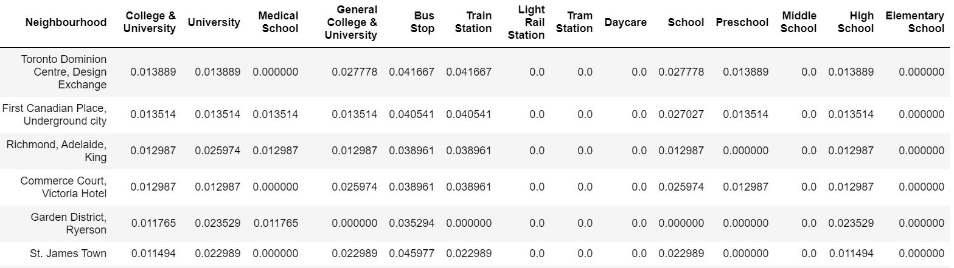
One hot encoded dataset snippet
Further mean() is performed on each column. Panda libraries are used for all data transformations

Slide 9
Calculation of Measures- Interested_Locations and Accessblity_Score
Maximum Number of occurences of venues that are of interest to business in each neighborhood is calculated as ‘Interested_Locations’.For example , the sum of number of occurence of schools, unversity,college in the specific neighborhood.
Maximum number of occurences of various public transport modes are calculated as ‘Accessiblity_score’.Example , the sum of number of occurence of Bus stop, train station etc. in the specific neighborhood.
Both entities will be used as measures to identify the better neighborhoods that suffice our Business scenario.

Slide 10
Identifying list of better neighborhoods for Renting
Filter the neighborhoods which have entities interested_location and accessblity_score >0.
The dataset now has only neighborhoods that has atleast one occurence of interested location like school and one of any mode of public transit.
This implies higher the value of entity interested_location, it has the maximum number of summation of locations like universities, schools and colleges. Similarly higher accessblity_score means more options of public transit available.

Slide 11
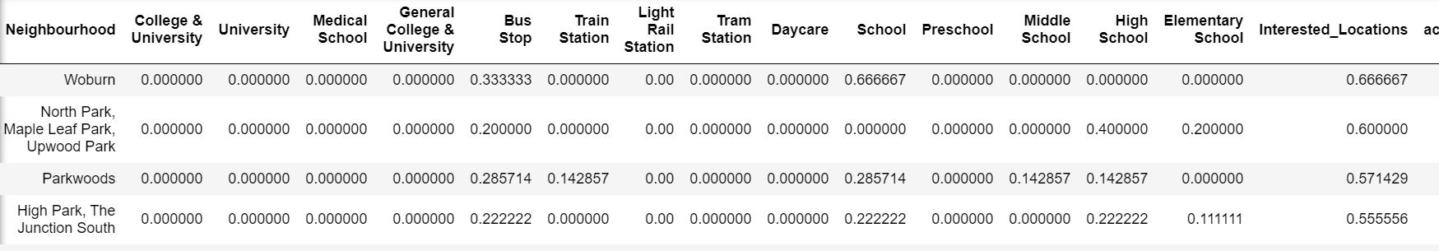
Dataset Snippet with Calculated , filtered and sorted Interested_Locations
The dataset contains 31 records that suffice the condition Interested_Locations> 0 and Accessblity_score > 0. These neighborhoods are identified as top options for renting out for our Business case.

Slide 12
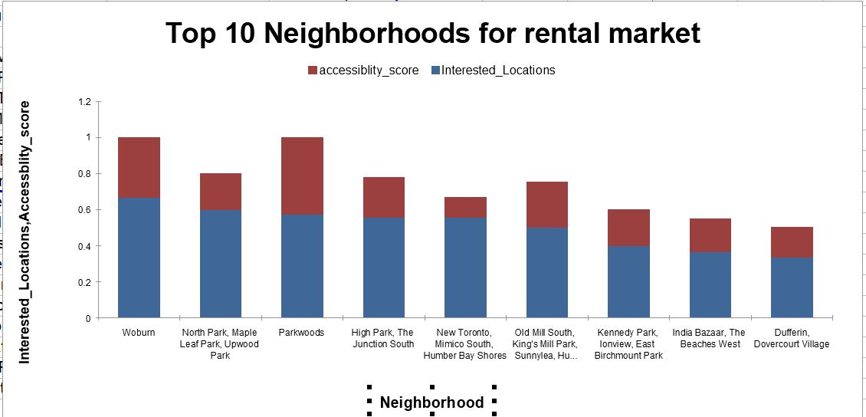
This plot only represents top 10 out of 31 neighborhood options our analysis provided. The dataset is sorted based on interested_location first followed by accessblity_score.

Slide 13
Clustering the top neighborhoods for rental market
k-Means Clustering algorithm used to cluster the resultant neighborhood list from our analysis.
k-means clustering is unsupervised machine learning algorithm used for the unlabeled data.It forms k groups within the available data points.
Best value of k= 4 found by elbow method using euclidean distance.
The dataset with top 10 most common venues of neighborhood forms the basis for clustering.

Slide 14
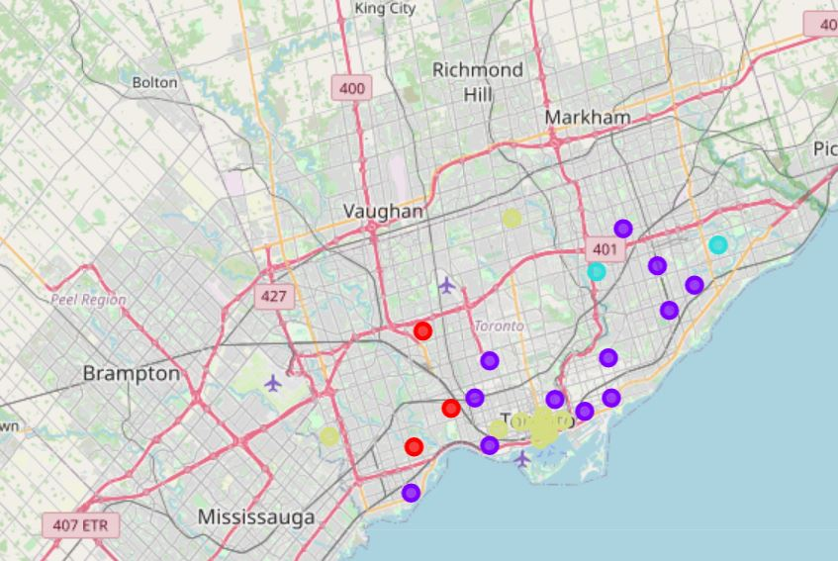
Toronto Map with superimposed Clusters
There are 4 clusters represented by 4 different colours .
Custer 0 in Red,Cluster 1 in purple, cluster 2 in turqoise and cluster 3 in yellow.

Slide 15
Analysis of Clusters
Cluster 0 has only schools in most common venues and maximum number of train stations out of other clusters.
Cluster 1 has a good mix of schools and colleges , but no bigger universities. However it is well connected with all modes of transit.
Cluster 2 has only schools with only bus stop in top common venues. Also it comprises of only 2 neighborhoods.
Cluster 3 has well connected neighborhoods with several universities and also have good number of schools and colleges. It has best bus transit facity out of the four.

Slide 16
Recommended Neighborhood
Cluster 3 has all of the locations of interest to the business. All the neighbourhoods are close to each other and can be accessed by residents in any of these neighborhood. Rental properties in Cluster 3 would giver better ROI .
Cluster 1 will be second choice. It has good number of schools and colleges with good transit options.

